Slide 1
IMAGE CLASSIFICATION USING CNN
Submit by:
M. Santhoshkumar,
||| - years & cse,
Register:912321104038,
Sacs mavmm engineering college,
Madurai.

Slide 2
OUTLINE:
Problem Statement
Proposed system/solution
System development Approach
Algorithm & deployment
Result
Conclusion
References

Slide 3
Problem statement:
An image classification problem involves assigning a label or category to an input image based on its contents. This is typically done using machine learning or deep learning algorithms to train a model on a dataset of labeled images, and then using that model to predict the label of new, unseen images.

Slide 4
Proposed Solutions:
1.CNN Architecture design:
*Input Layer,Convolutional Layer (with Reactivation), MaxPooling Layer,Convolutional Layer (with Reactivation),MaxPooling Layer, Flatten Layer, Fully Connected Layer (with ReLU activation),Output Layer (with softmax activation
2.Generator:
*On the other hand, image classification involves categorizing images into predefined classes or labels based on their content.
*This is typically done using classification algorithms such as Convolutional Neural Networks (CNNs)

Slide 5
Proposed solution: (Contd...)
Convolution Neural Network:
*It Seems like you’re referring to a task related to image classification using convolutional neural networks (CNNs).
* Image classification involves categorizing images into predefined classes or categories.
*CNNs, a type of deep learning model, are commonly used for image classification tasks due to their ability to effectively capture spatial hierarchies and patterns within images.

Slide 6
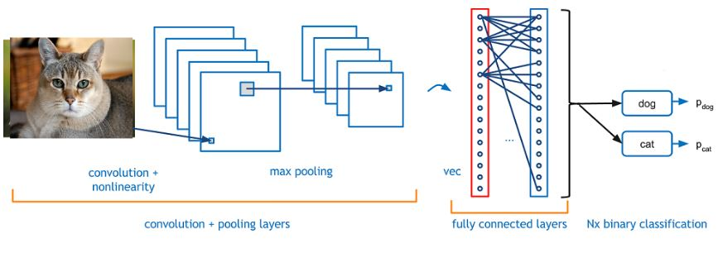
Proposed Solutions:(Contd...)
Convolutional Neural Network

Slide 7
System development approach: (Contd...)
System Requirements: 1.Hard ware Requirements:
*GPU Acceleration:
*Graphics Processing Units (GPUs) are commonly used to accelerate deep learning computations due to their highly parallel architecture.
*Many deep learning frameworks, such as Tensor Flow and PyTorch, support GPU acceleration, allowing CNN models to be trained and deployed more efficiently.

Slide 8
System development approach: (Contd...)
Hard Ware Requirements:
Build the CNN Model:
*Initialize a CNN model (you can use frameworks like Tensor Flow or PyTorch).
*Stack convolutional layers, pooling layers, and optionally dropout layers to prevent overfitting.
*Flatten the output and connect it to fully connected layers. *Add an output layer with softmax activation for multi-class classification.

Slide 9
System development approach: (Contd...)
Hard Ware Requirements:
*Model Optimization:
*Techniques such as model quantization, pruning, and compression can reduce the computational and memory requirements of CNN models.
*making them more suitable for deployment on resource-constrained hardware systems without significantly sacrificing accuracy.
*Distributed Computing:
*Distributing CNN computations across multiple hardware devices or nodes can improve scalability.
*Reduce inference latency, enabling real-time image classification in large-scale systems.

Slide 10
System development approach:(Contd...)
Hard ware requirements:
*Edge Computing:
*Edge computing is a distributed computing framework that brings enterprise applications closer to data sources such as IoT devices or local edge servers.
*This proximity to data at its source can deliver strong business benefits, including faster insights, improved response times and better bandwidth availability

Slide 11
Algorithm &deployment:
2.Software requirements
*Data Collection and Pre-processing: *Collect a labelled dataset of images for training the CNN
*pre-process the images, including resizing, normalization, and augmentation, to ensure consistency and improve model generalization.
* Model Training: * Choose a CNN architecture suitable for image classification tasks, such as VGG, ResNet, or Mobile Net .
*Train the CNN model using the labelled dataset, optimizing it to minimize classification error using techniques like backpropagation and gradient descent.
*Validate the trained model using a separate validation dataset

Slide 12
Algorithm &deployment:(Contd...)
Software Requirements
*Model Evaluation and Fine-tuning: *Evaluate the performance of the trained model using a test dataset, assessing metrics such as accuracy, precision, recall, and F1 score.
* Fine-tune the model if necessary, adjusting hyper parameters, architecture, or training data to improve performance
*Model Deployment: *Choose a deployment environment suitable for the application’s requirements, such as cloud-based servers, edge devices, or IoT devices.
*Convert the trained model into a format compatible with the deployment environment, such as Tensor Flow's Saved Model.

Slide 13
Algorithm & deployment: (Contd...)
*Testing and Monitoring:
*Test the deployed model in a real-world environment, validating its performance and identifying any issues or discrepancies.
* Monitor the model’s performance over time, collecting metrics and feedback to assess its effectiveness and reliability.
*Implement mechanisms for model updates and maintenance, ensuring continuous improvement and adaptation to evolving requirements.

Slide 14
Algorithm & Deployment: (Contd...)
Security and Compliance:
*Implement security measures to protect the deployed model from potential threats, such as adversarial attacks or data breaches.

Slide 15
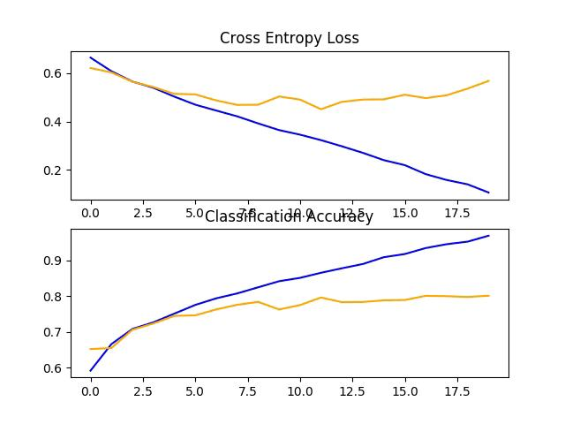
Results:

Slide 16
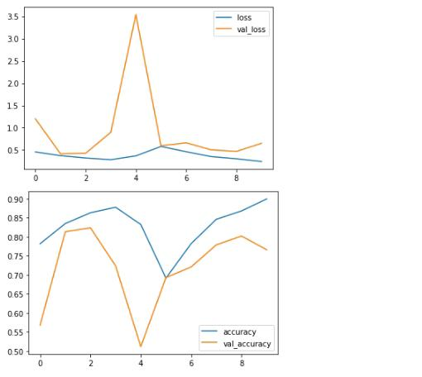
Results:

Slide 17
Conclusion:
Image classification using convolutional neural networks (CNNs) is a powerful technique for automatically categorizing images into predefined classes or categories. Through the use of deep learning architectures specifically designed for processing visual data, CNNs have demonstrated remarkable performance across a wide range of image recognition tasks.

Slide 18
Reference:
*https://blog.keras.io/building-powerful-image-classification-models-using-very-little-data.html
*https://www.analyticsvidhya.com/blog/2022/01/image-classification-using-machine-learning/
*https://neptune.ai/blog/category/computer-vision
*https://github.com/fchollet/keras-blog/blob/gh-pages/building-powerful-image-classification-models-using-very-little-data.html￼￼￼￼￼￼￼￼￼￼￼￼￼￼￼￼￼￼￼￼￼￼￼

Slide 19
Thank You

